Slide 1


CS 153: Concepts of Compiler Design September 8 Class Meeting
Department of Computer Science San Jose State University Fall 2020 Instructor: Ron Mak
www.cs.sjsu.edu/~mak

Slide 2
Assignment #3: Parser and Executor
Modify the frontend parser to parse and build trees for the following Pascal statements:
while
if
for
case
You may need to add new node types in the intermediate tier.
Add new visit methods to the backend executor to execute the above statements.
Some simple Pascal source files
are forthcoming to test your interpreter.

Slide 3
Assignment #3, cont’d
You can start Assignment #3 using the code you wrote for Assignment #2, or you can use the suggested solution: http://www.cs.sjsu.edu/~mak/CS153/assignments/2/solution/Asgn02Java.zip (Java version).
There are simple Pascal input test files for you to test the statements that you’re implementing.
You should make up simpler tests files before attempting these.
Demo

Slide 4
The “Dangling” ELSE
Consider:
Which THEN does the ELSE pair with?
Is it: IF i = 3 THEN IF j = 2 THEN t := 500 ELSE f := -500
Or is it: IF i = 3 THEN IF j = 2 THEN t := 500 ELSE f := -500
IF i = 3 THEN IF j = 2 THEN t := 500 ELSE f := -500

Slide 5
The “Dangling” ELSE, cont’d
According to Pascal syntax, the nested IF statement is the THEN statement of the outer IF statement IF i = 3 THEN IF j = 2 THEN t := 500 ELSE f := -500
Therefore, the ELSE pairs with the closest (i.e., the second) THEN.

Slide 6
Scanner and Parser Rules of Thumb
Scanner
At any point in the source file, extract the longest possible token.
Example:
<= is a single less-than-or-equal token
Not a greater-than token followed by an equal token
Parser
At any point in the source file, parse the longest possible statement.
Example: IF i = 3 THEN IF j = 2 THEN t := 500 ELSE f := -500
“maximum munch”

Slide 7
An Executor Improvement
The suggested solution to Assignment #2 implements a significant improvement.
The main no longer passes the symbol table to the backend executor.
It was passed to the constructor of class Executor.
Since we’re using the hack of storing the runtime values of variables in symbol table entries, how is this possible?

Slide 8
Syntax and Semantics
Syntax refers to the rules of the grammar of a source language.
The rules prescribe the proper form of its programs.
The parser “knows” the grammar.
Rules can be described by syntax diagrams.
Syntax checking
Does this sequence of tokens follow the syntax rules?
Performed by the frontend parser.

Slide 9
Syntax and Semantics, cont’d
Semantics refers to the meaning of syntactically correct token sequences of the source language.
Example: Certain sequences of tokens constitute an IF statement according to the language’s grammar.
The semantics of the statement determine
How the interpreter will execute the statement, or
How the compiler or converter will generate object code for the statement.

Slide 10
Syntax and Semantics, cont’d
Semantic actions by the frontend parser based on the meanings of statements and expressions:
Building proper parse trees.
Building symbol tables.
Type checking (which we’ll do later).
The parse trees encode type checking and operator precedence in their structures.

Slide 11
Syntax and Semantics, cont’d
Semantic actions in the back end:
Interpreter: The executor runs the program and performs actions according to the meanings of the statements and expressions.
Compiler and converter: The code generator emits object code that reflects the meanings of the statements and expressions.

Slide 12
Syntax Error Handling
Syntax error handling in the front end is a three-step process:
Detect the error.
Flag the error.
Recover from the error.
Good syntax error handling is important!
A hallmark of a compiler excellence.

Slide 13
Options for Error Recovery
Stop after the first error.
No error recovery at all.
Easiest for the compiler writer, annoying for the programmer.
Worse case: The compiler crashes or hangs.
Become hopelessly lost.
Attempt to continue parsing the rest of the source program.
Spew out lots of irrelevant and meaningless error messages.
No error recovery here, either …
… but the compiler writer doesn’t admit it!

Slide 14
Options for Error Recovery, cont’d
Skip tokens after the erroneous token until …
The parser finds a token it recognizes, and
It can safely resume syntax checking the rest of the source program.
For now, we’ve implemented very simple syntax error handling.
Will our parser get lost attempting to recover?
Will our parser crash?

Slide 15
Top Down Recursive Descent Parsing
The term is very descriptive of how the parser works.
Start by parsing the topmost source language construct.
Example: The program
Separate parse methods for the various language constructs.
Examples: parseProgram(), parseAssignmentStatement(), parseExpression(), etc.

Slide 16
Top Down Recursive Descent Parsing, cont’d
Drill down (descend) by parsing the sub-constructs.
Parse methods call lower-level parse methods.
statement →assignment statement → expression →variable → etc.
Use recursion on the way down.
statement →WHILE statement → statement → etc.

Slide 17
Top Down Recursive Descent Parsing, cont’d
This is the technique for hand-coded parsers.
Very easy to understand and write.
The source language’s grammar is encoded in the structure of the parser methods.
Close correspondence between the parser code and the syntax diagrams.
Disadvantages
Can be tedious coding.
Ad hoc error handling.
Big and slow!

Slide 18
Top Down Recursive Descent Parsing, cont’d
Bottom-up parsers can be smaller and faster.
Error handling can still be tricky.
To be covered later this semester.

Slide 19
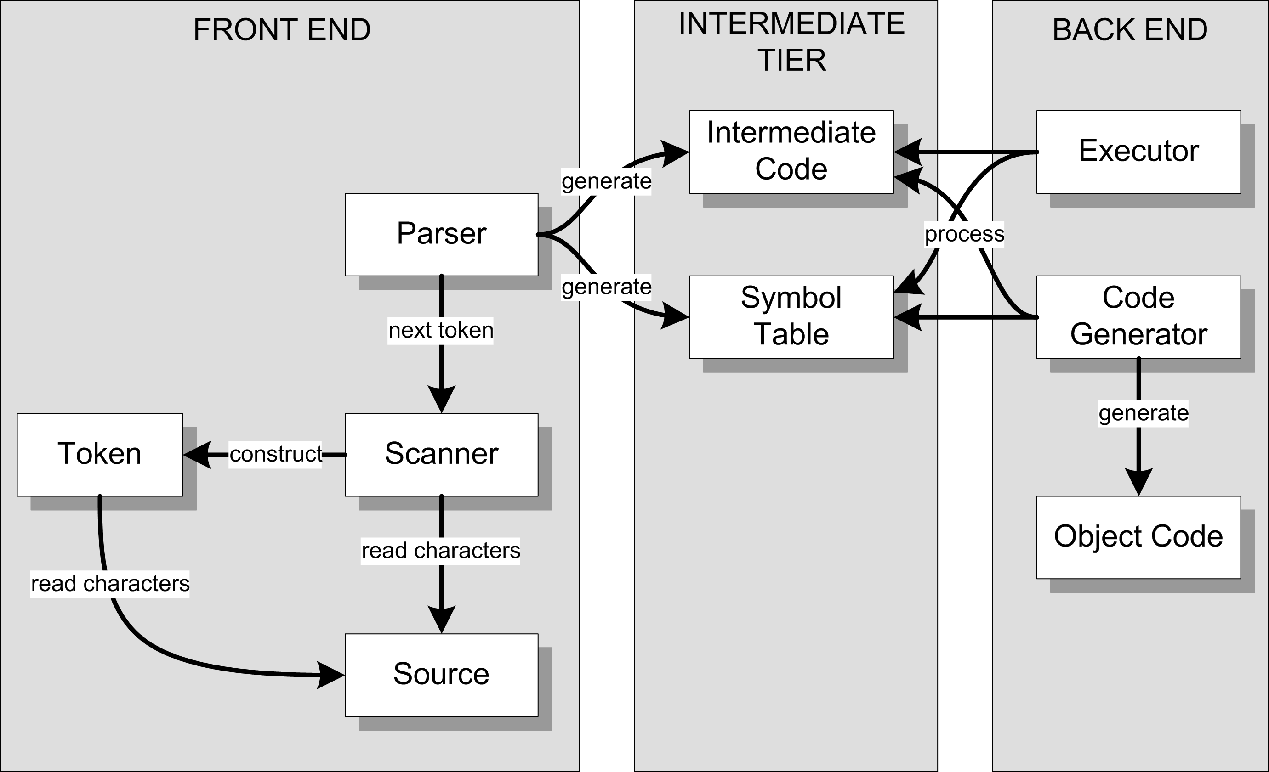
Our Accomplishments So Far
Interpreter
Compiler or
converter

Slide 20
Our Accomplishments So Far, cont’d
Overall structure of a language translator.
Front end, intermediate tier, and back end.
Parser, scanner, and tokens in the front end.
Parse trees and symbol tables in the intermediate tier.
An interpreter for simple Pascal with a working executor in the back end.

Slide 21
Scripting Engine
We now have a simple scripting engine!
We can execute:
Expressions
Assignment statements
Control statements
Compound statements
Scalar and string variables that are untyped

Slide 22
Temporary Hacks for Now
Only one parse tree and one symbol table.
There will be several parse trees and symbol tables.
Variables are scalars (not records or arrays) but otherwise have no declared type.
We haven’t parsed any Pascal declarations yet!
We consider a variable to be “declared” (and we enter it into the symbol table) the first time it appears on the left-hand side of an assignment statement.
We store runtime values of variables in the symbol table.

Slide 23
Can We Build a Better Scanner?
Our scanner in the front end is relatively easy to understand and follow.
Separate token methods for each token type: word(), number(), specialSymbol(), etc.
However, it’s big and slow.
Creates lots of token objects.
Makes lots of method calls.
Write a more compact and faster scanner.
However, it may be harder to understand and follow.

Slide 24
Deterministic Finite Automata (DFA)
Pascal identifier
Regular expression: <letter> ( <letter> | <digit> )*
Implement the regular expression with a finite automaton (AKA finite state machine):
letter
1
letter
2
[other]
3
digit

Slide 25
Deterministic Finite Automata (DFA)
This automaton is a deterministic finite automaton (DFA).
At each state, the next input character uniquely determines which transition to take to the next state.
start state
letter
accepting state
1
letter
2
[other]
3
transition
digit

Slide 26
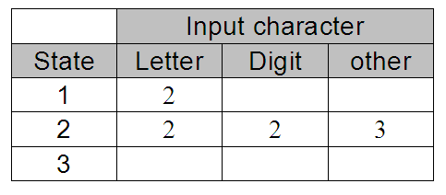
State-Transition Matrix
letter
1
letter
2
[other]
3
digit
Represent the behavior of a DFA by a state-transition matrix:

Slide 27
DFA for a Pascal Number
E
digit
digit
digit
digit
.
+
0
+
3
digit
4
6
digit
7
E
9
10
digit
11
[other]
12
-
-
digit
[other]
[other]
5
8
Note that this diagram allows only an upper-case E for an exponent.
What changes are required to also allow a lower-case e?

Slide 28
DFA for a Pascal Identifier or Number
private static final int matrix[][] = {
/* letter digit + - . E other */
/* 0 */ { 1, 4, 3, 3, ERR, 1, ERR },
/* 1 */ { 1, 1, -2, -2, -2, 1, -2 },
/* 2 */ { ERR, ERR, ERR, ERR, ERR, ERR, ERR },
/* 3 */ { ERR, 4, ERR, ERR, ERR, ERR, ERR },
/* 4 */ { -5, 4, -5, -5, 6, 9, -5 },
/* 5 */ { ERR, ERR, ERR, ERR, ERR, ERR, ERR },
/* 6 */ { ERR, 7, ERR, ERR, ERR, ERR, ERR },
/* 7 */ { -8, 7, -8, -8, -8, 9, -8 },
/* 8 */ { ERR, ERR, ERR, ERR, ERR, ERR, ERR },
/* 9 */ { ERR, 11, 10, 10, ERR, ERR, ERR },
/* 10 */ { ERR, 11, ERR, ERR, ERR, ERR, ERR },
/* 11 */ { -12, 11, -12, -12, -12, -12, -12 },
/* 12 */ { ERR, ERR, ERR, ERR, ERR, ERR, ERR },
};
Negative numbers
in the matrix are the
accepting states.
letter
0
letter
1
[other]
2
digit
+
-
digit
E
digit
digit
digit
digit
.
+
3
4
6
digit
7
E
9
10
digit
11
[other]
12
digit
-
[other]
[other]
Notice how the
letter E is handled!
5
8

Slide 29
A Simple DFA Scanner
public class SimpleDFAScanner
{
// Input characters.
private static final int LETTER = 0;
private static final int DIGIT = 1;
private static final int PLUS = 2;
private static final int MINUS = 3;
private static final int DOT = 4;
private static final int E = 5;
private static final int OTHER = 6;
private static final int ERR = -99999; // error state
private static final int matrix[][] = { ... };
private char ch; // current input character
private int state; // current state
...
}

Slide 30
A Simple DFA Scanner, cont’d
int typeOf(char ch)
{
return (ch == 'E') ? E
: Character.isLetter(ch) ? LETTER
: Character.isDigit(ch) ? DIGIT
: (ch == '+') ? PLUS
: (ch == '-') ? MINUS
: (ch == '.') ? DOT
: OTHER;
}

Slide 31
A Simple DFA Scanner, cont’d
private String nextToken()
throws IOException
{
while (Character.isWhitespace(ch)) nextChar();
if (ch == 0) return null; // EOF?
state = 0; // start state
StringBuilder buffer = new StringBuilder();
while (state >= 0) { // not accepting state
state = matrix[state][typeOf(ch)]; // transit
if ((state >= 0) || (state == ERR)) {
buffer.append(ch); // build token string
nextChar();
}
}
return buffer.toString();
}
This is the
heart of the
scanner.
Table-driven scanners
can be very fast!

Slide 32
A Simple DFA Scanner, cont’d
private void scan()
throws IOException
{
nextChar();
while (ch != 0) { // EOF?
String token = nextToken();
if (token != null) {
System.out.print("=====> \"" + token + "\" ");
String tokenType =
(state == -2) ? "IDENTIFIER"
: (state == -5) ? "INTEGER"
: (state == -8) ? "REAL (fraction only)"
: (state == -12) ? "REAL"
: "*** ERROR ***";
System.out.println(tokenType);
}
}
}
How do we know which token we just got?
Demo

